Slide 1

Robot Arm Reach
CS 5180 – Reinforcement Learning – Fall 22
Team Members:
Anuj Shrivatsav Srikanth
Kenechi Franklin Dukor
Sahasrajit Anantharamakrishnan

Slide 2
Problem Formulation
Task: Move the end-effector to target location; Agent controls the position of the robot arm.
Goal is when agents’ end-effector is within 0.05m of target.
Environment Specification
We utilize panda-gym which makes use of the PyBullet physics engine.
Franka Emika 2 robotic arm.
A 7-degrees of freedom (DoF) arm with a parallel finger gripper as the end-effector.
Panda-gym, an open-source library integrated with OpenAI-gym
The target position is randomly generated in a volume of 30 cm × 30 cm × 30 cm.

Slide 3
Approach
Continuous Action Space
Three different Policy Gradient Methods:
Deep Deterministic Policy Gradients (DDPG)
Soft Actor-Critic (SAC)
Twin Delayed Deep Deterministic Policy Gradients (TD3)
The observation space is 6-Dimensional
Position of the Gripper – 3 values
Speed of the Gripper – 3 values
The action space is 3-Dimensional
X in [-1, 1] cm
Y in [-1, 1] cm
Z in [-1, 1] cm

Slide 4
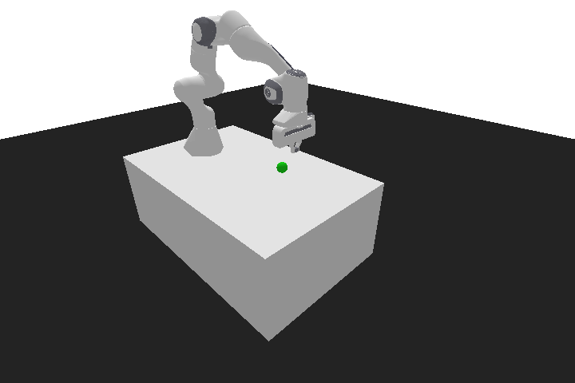
Initial Results
Agent was trained with implementations of DDPG, TD3, SAC and PPO on stable baseline 3.
Hyperparameters and Setup:
Timesteps – 70,000
Gamma – 0.95
Learning rate – 0.0001
Batch size – 2048
Buffer size – 10,000
Network Architecture:
Actor – 3 hidden layers of 512 nodes each.
Number Critics – 2
PPO algorithm performed poorly, and we believe this is because it is an off-policy method.

Slide 5
Initial Results
 | DDPG | SAC | TD3
Actor Loss | 0.0889 | 0.101 | 0.0942
Critic Loss | 0.00718 | 0.00321 | 0.00432
Mean Reward | -2.09 | -1.74 | -2.12
Starting Reward | -50 | -50 | -50

Slide 6
Further Work
Train the agent on our implementation of the aforementioned algorithms.
Compare performance between the algorithms.
Compare our methods with the results of stable baseline.
Extension of the algorithm with different and tougher tasks such as Robot-Arm push or Robot-Arm Pick and Place.

Slide 7
Thank You!

